Slide 1

THYNK UNLIMITED
WE LEARN FOR THE FUTURE
DISEASE PREDICTION & MACHINE LEARNING
PRESENTATION
PRESENTED BY:
RAFAT ALKHATIB

Slide 2
INTRODUCTION
Imagine a world where machines can decipher languages, recognize faces, diagnose diseases, and even make predictions without explicit programming.
We will embark on a journey through the ever-evolving landscape of Artificial Intelligence and Machine Learning. We'll explore the core concepts, real-world applications, and the transformative potential of these technologies.

Slide 3
HISTORICAL CONTEXT
The problem and Task
The datasets and visualization
The models and metrics

Slide 4
WHAT IS THE PROBLEM?
Problem Statement: Market Price Prediction
Background:
In the realm of market analysis and forecasting, understanding the intricate patterns within time series
data is paramount for informed decision-making. With the advent of machine learning techniques, it's
now possible to delve deeper into historical market data to predict future trends accurately. In this
context, we have at our disposal a dataset containing monthly market data spanning multiple years,
encompassing various regions, commodities, and pricing information.

Slide 5
WHAT ARE THE OBJECTIVE ?
Objective:
The primary objective of this project is to develop a robust time series machine learning model capable of accurately forecasting market trends based on historical data. By leveraging advanced algorithms, we aim to predict the quantity and prices of commodities for future months, empowering stakeholders to make proactive decisions regarding production, procurement, pricing strategies, and resource allocation.

Slide 6
WHAT IS THE TASK?
Task:
The task involves several key steps:
1. Data Preprocessing: Cleaning the dataset, handling missing values, and encoding categorical variables.
2. Exploratory Data Analysis (EDA): Analyzing the temporal patterns, identifying seasonality, trends, and
anomalies within the data.
3. Feature Engineering: Creating relevant features such as lagged variables, rolling statistics, and seasonal indicators.

Slide 7
WHAT IS THE TASK?
part-2
Task:
4. Model Selection and Training: Evaluating various time series forecasting models such as ARIMA,
SARIMA, Prophet, and LSTM, selecting the most suitable one, and training it on the dataset.
5. Model Evaluation: Assessing the model's performance using appropriate metrics such as Mean Absolute Error (MAE), Mean Squared Error (MSE), and Root Mean Squared Error (RMSE).
6. Fine-tuning and Validation: Fine-tuning the model parameters, validating its performance on unseen
data, and iterating if necessary.

Slide 8
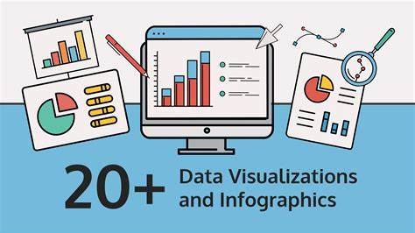

Slide 9
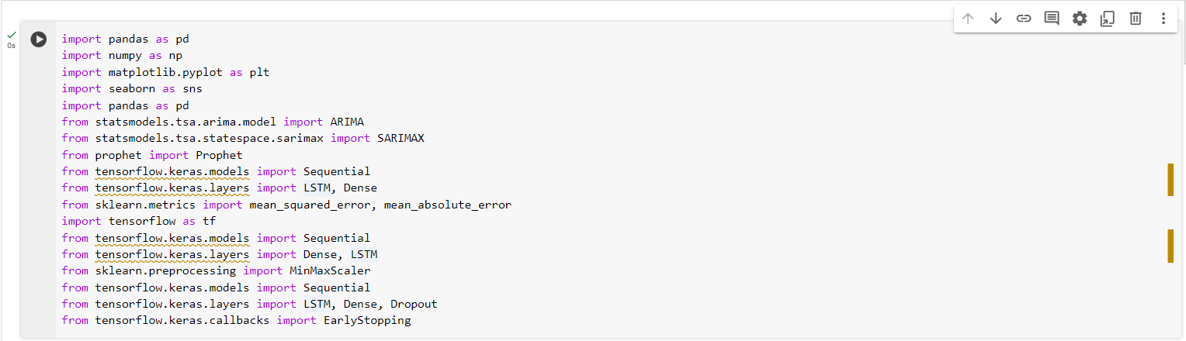
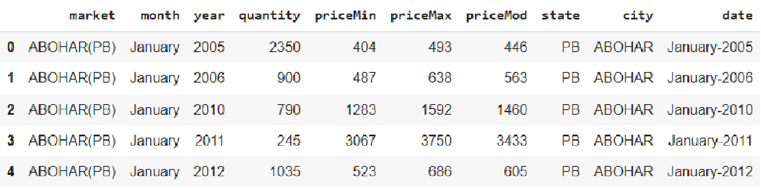
The suitable library
The Data Table

Slide 10
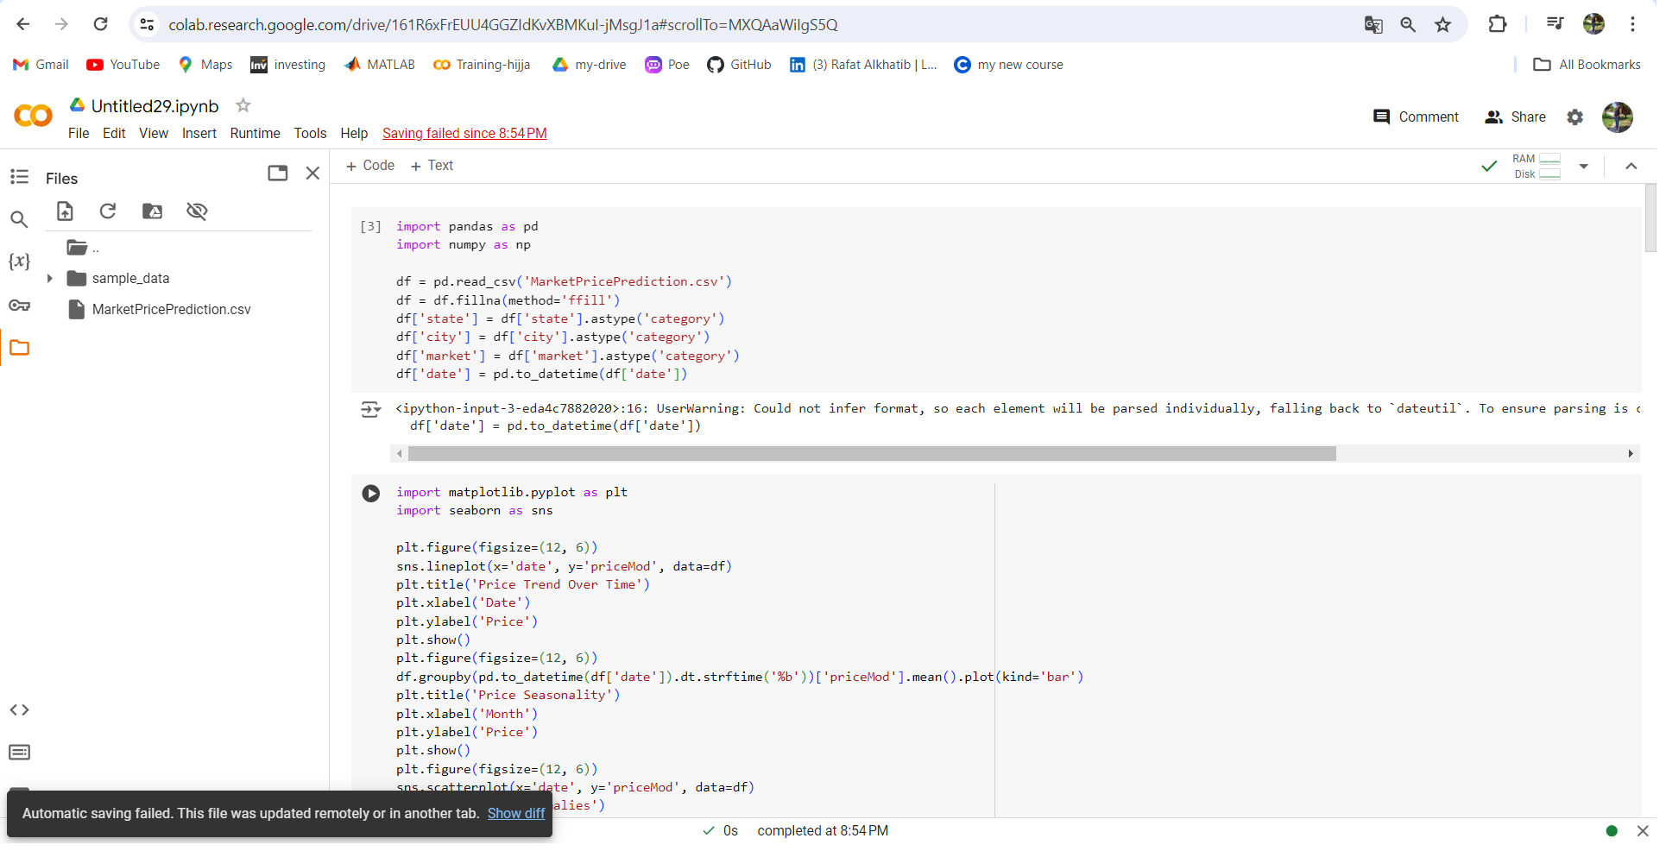
pre-processing and visulization

Slide 11
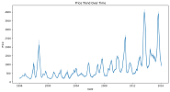
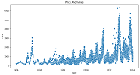
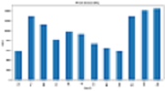

Slide 12
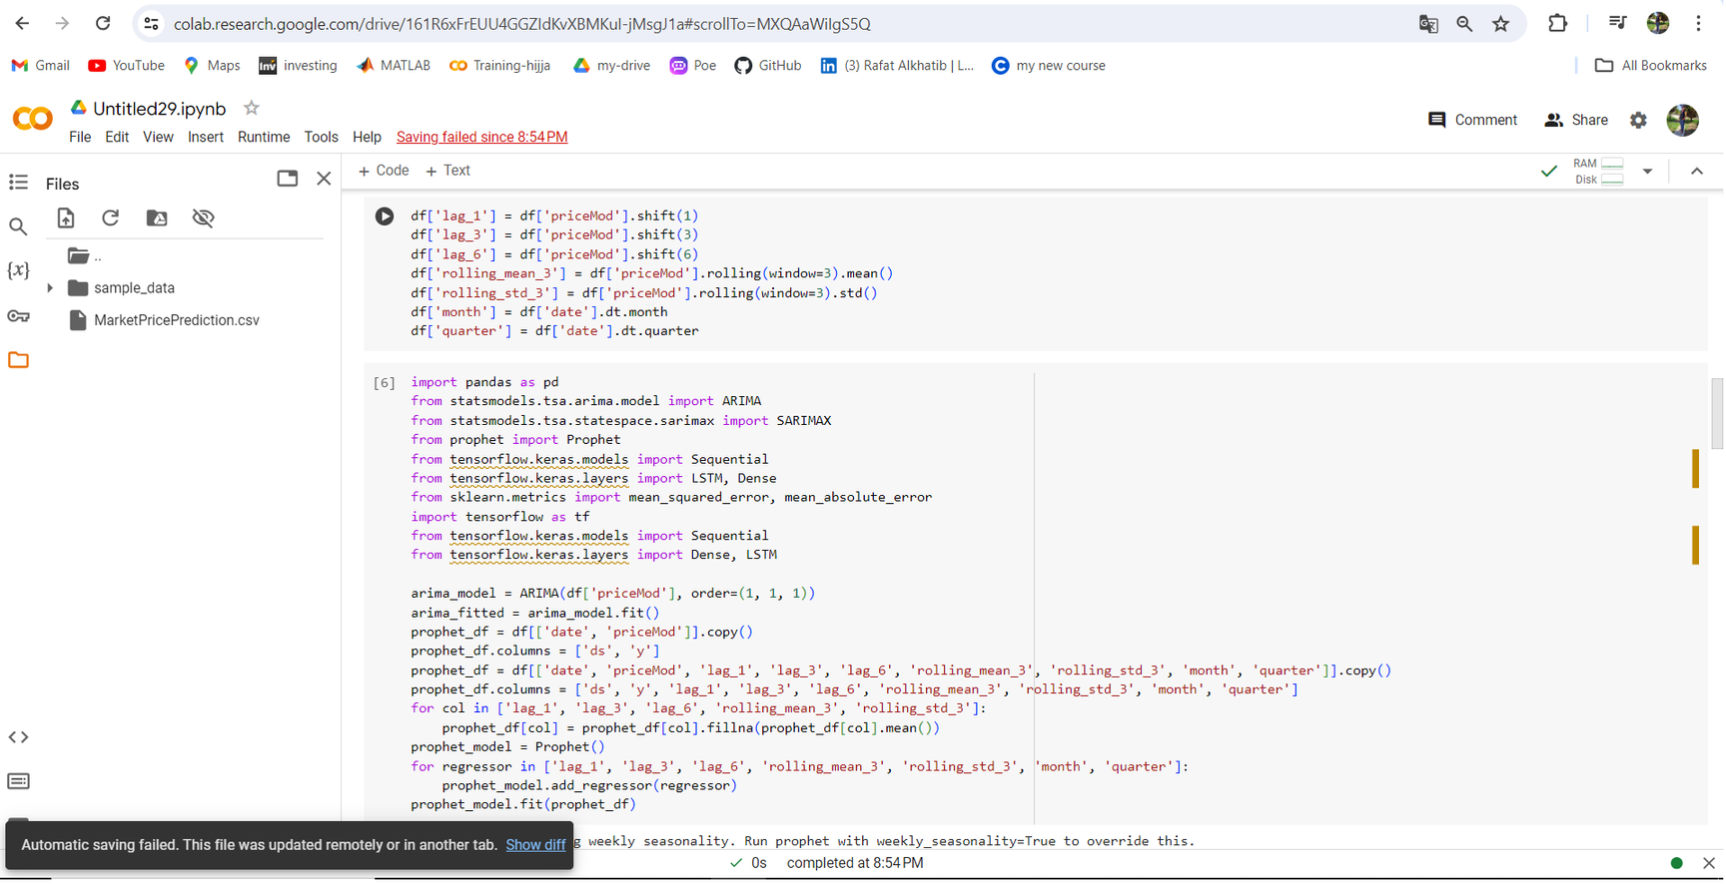
lagged variables, rolling statistics, and seasonal indicators and ARIMA, Prophet ,models.

Slide 13
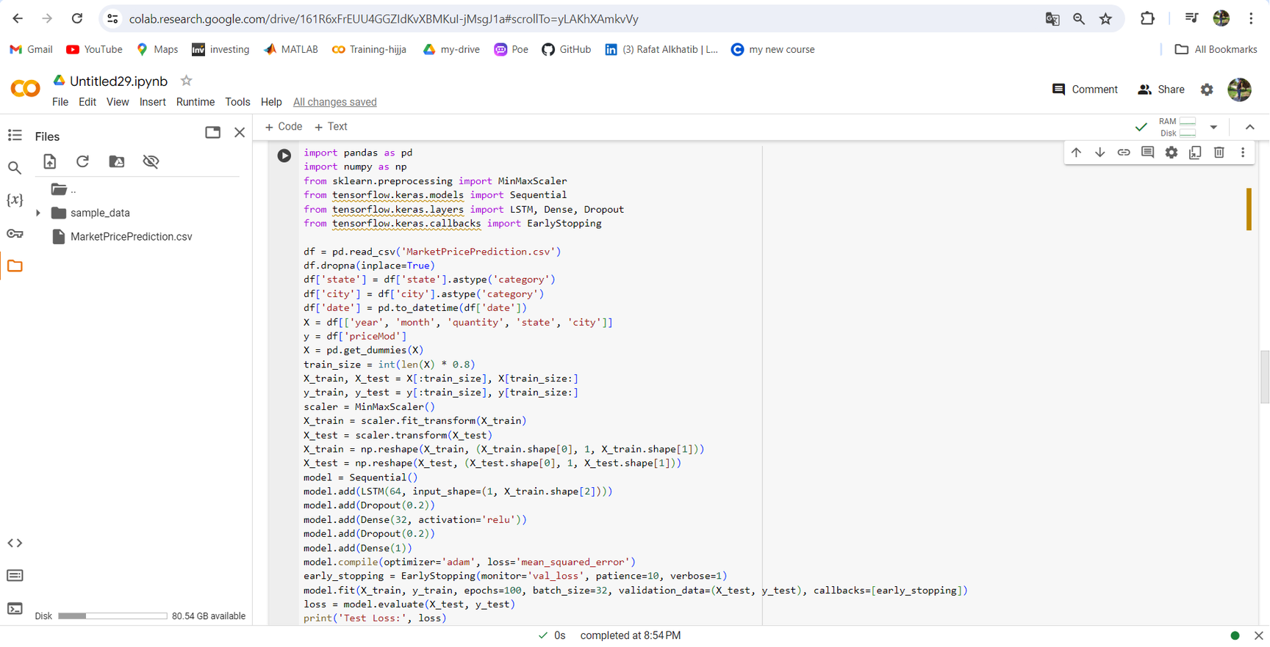
LSTM

Slide 14
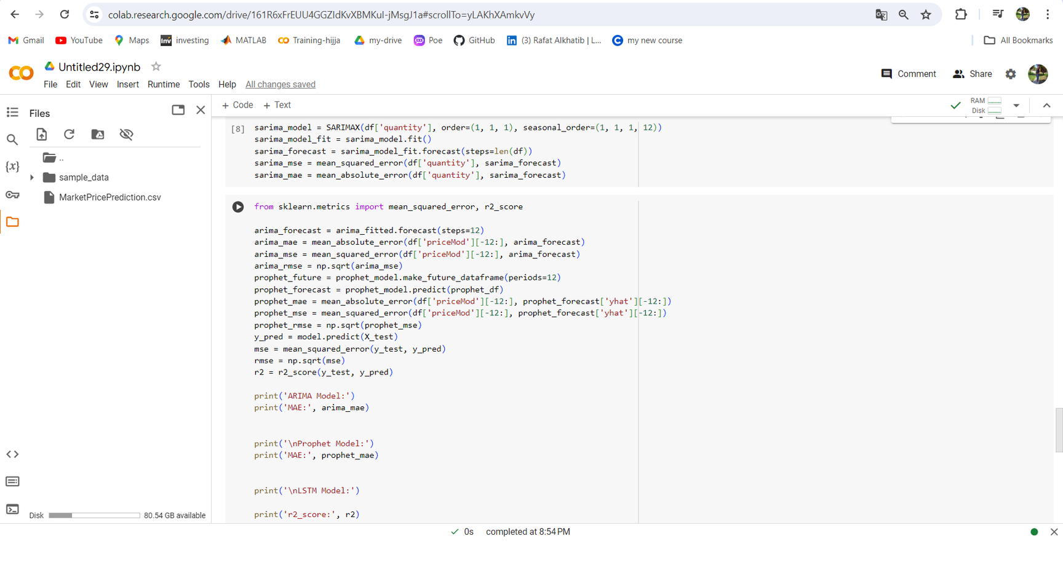
SARIMA and Metrics
Models | ARIMA | Prophet | LSTM
Metrics | 399.32328496745316 | 429.1891438163693 | 0.5712772529652036

Slide 15
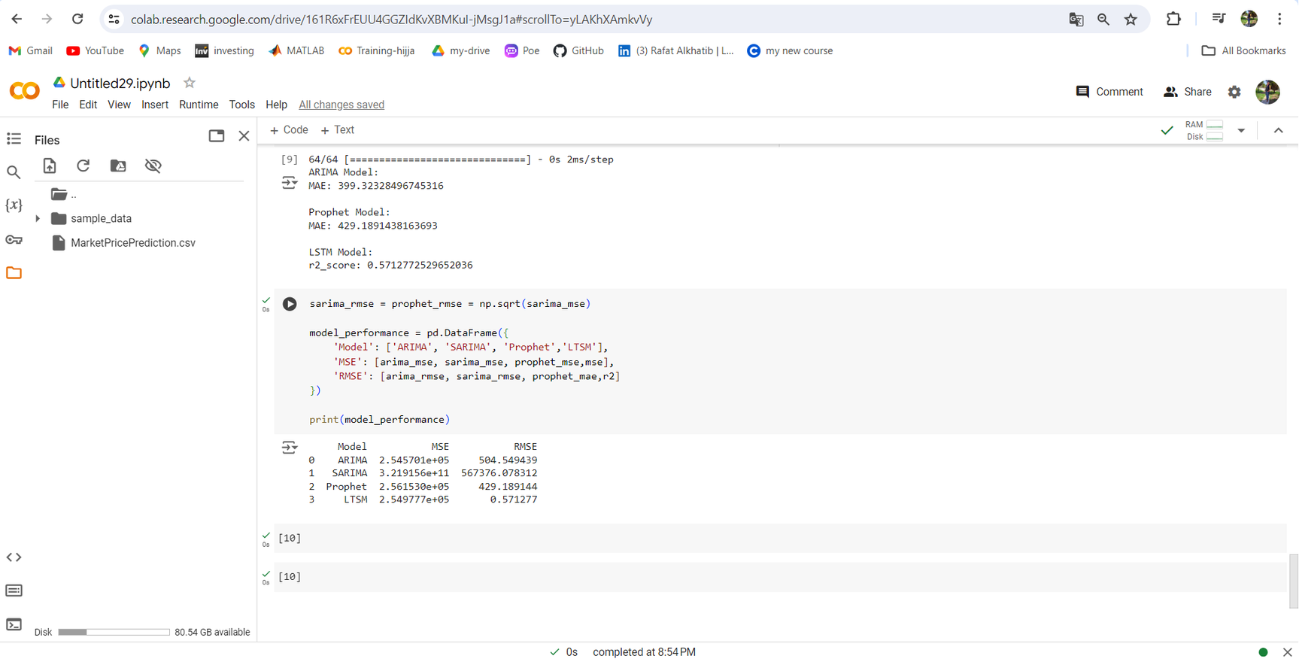
Model | MSE | RMSE
ARIMA | 2.545701e+05 | 504.549439
SARIMA | 3.219156e+11 | 567376.078312
Prophet | 2.561530e+05 | 429.189144
LTSM | 2.549777e+05 | 0.571277
THE BEST OF LTSM

Slide 16


